Slide 1
Performance Analysis on Multi-Agent Reinforcement Learning Environments
CSE 4/546 – Reinforcement Learning, Instructor – Alina Vereshchaka
Team – 17
Thilak Reddy Dharam – thilakre – 50469154
Dhanush Kumar Reddy Yarragonda – dhanushk - 50468303

Slide 2
Introduction to Multi-Agent Environments and Game-Theoretic Analysis
Multi-Agent Environments - Dynamic interaction of multiple agents within various environments.
Performance Analysis - Assessing agent behavior and interaction for improved decision-making and adaptability.
Game-Theoretic Analysis - Incorporating strategic decision-making frameworks to optimize reinforcement learning Real-
Real world AI Applications - Developing more resilient and adaptable AI systems for real-world challenges.

Slide 3

Environment Analysis
ROCK PAPER SCISSORS
The Rock-Paper-Scissor class represents a two-player game environment for Rock, Paper, Scissors, using OpenAI's gym library. It has visual representation for the actions and allows players to perform actions, receive rewards based on action outcomes, and visualize the game's progress.
It is a One-state MDP
Players choose from three actions (Rock, Paper, Scissors)
Rewards: winning (+1), tie (0), lose (-1)

Slide 4
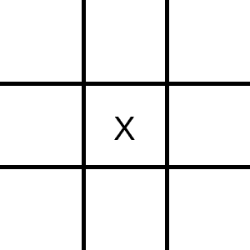
Tic-Tac-Toe
The Tic-Tac-Toe represents a 2-player game for the game Tic-Tac-Toe, defined using OpenAI's gym library.
The game board is a 3x3 grid where players take turns to place their symbol (X or O). The environment tracks the state of the game, available actions, and rewards.
It provides methods to take a step (make a move), reset the game, render the game state visually, and check for a game winner.
It contains 18 joint actions and 19,683 states.
Rewards: winning (+1), draw (0), lose (-1).

Slide 5
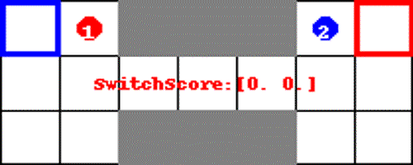
Switch Game
The Switch Game represents a multi-agent reinforcement learning environment. It simulates a grid-based game where agents move around trying to reach their respective goals while avoiding obstacles.
The environment is configurable, supporting both full and partial observability modes, customizable step costs.
It allows actions like moving in four directions or staying in place.
Discrete action space (5 directions per agent).
Continuous observation space (agent positions, steps).
Rewards: Agent reaches its destination gets reward of 5 points else 0.

Slide 6
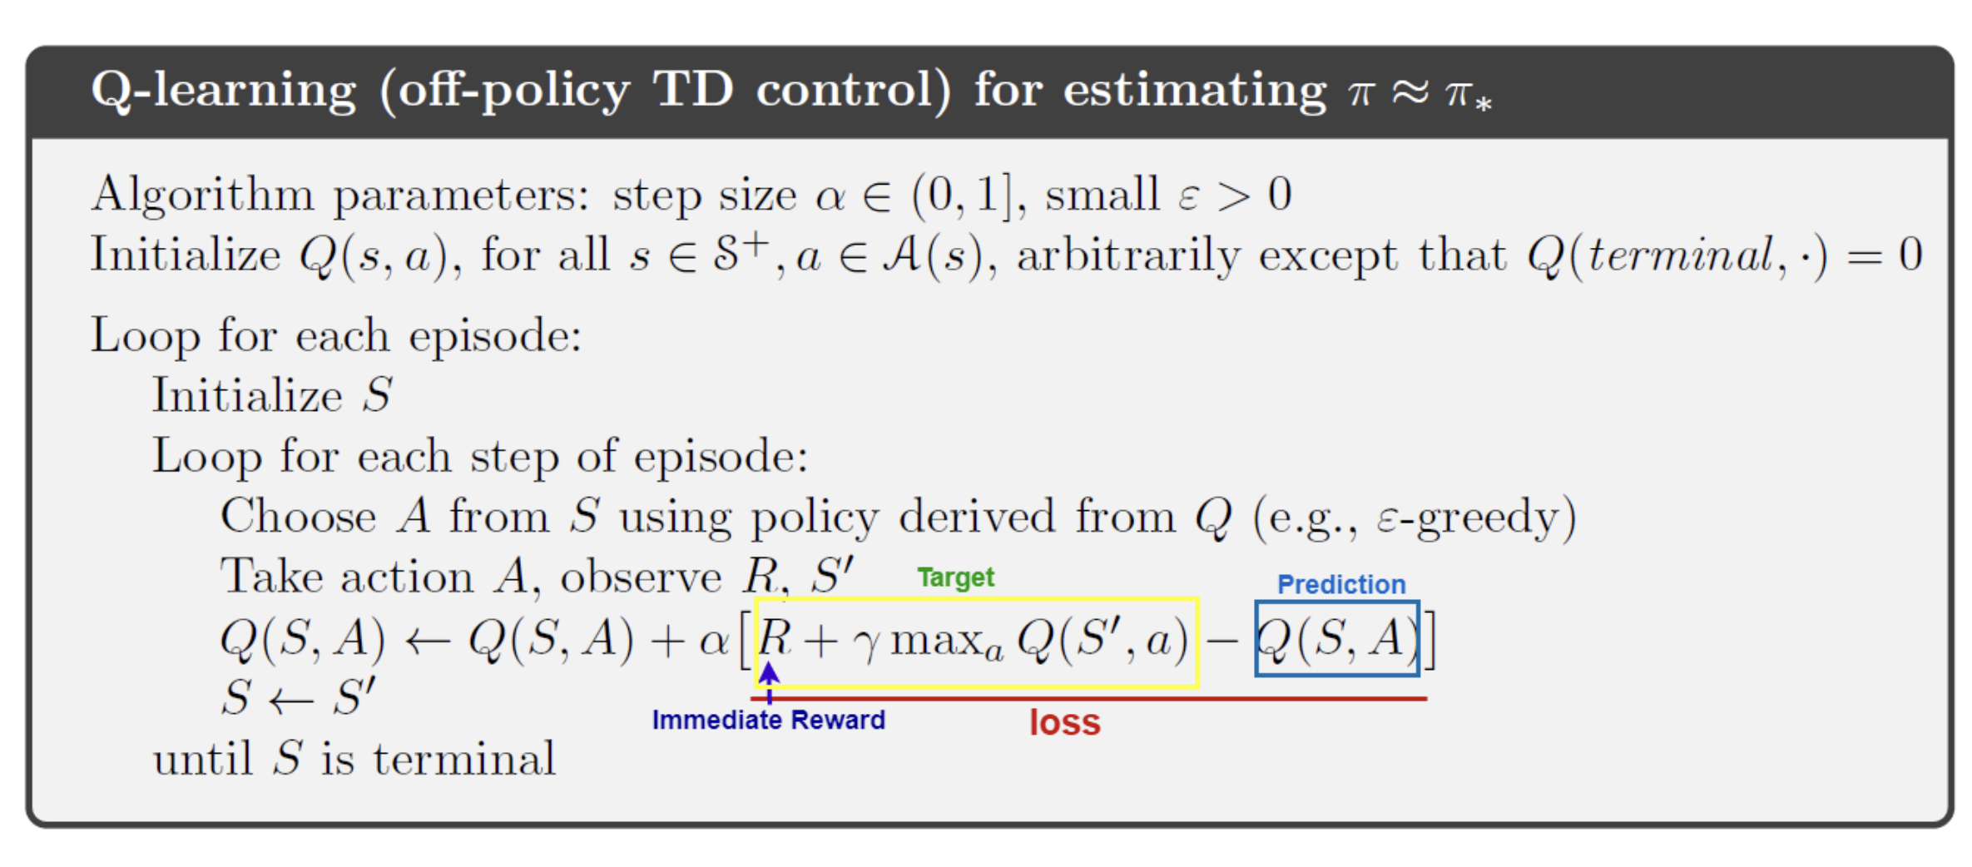
Algorithm Analysis
Q-Learning
Q-Learning is a model-free reinforcement learning algorithm. The goal of Q-Learning is to learn a policy that tells an agent which action to take under what circumstances.
Q-Learning works by learning an action-value function that ultimately gives the expected utility of taking a given action in a given state and following a fixed policy thereafter.
Each agent's Q-value (Q(s, a)) is updated using the formula
Q(s, a) = (1 - α)Q(s, a) + α(r + γ max Q'(s', a')), considering each agent's action (a) and state (s)

Slide 7
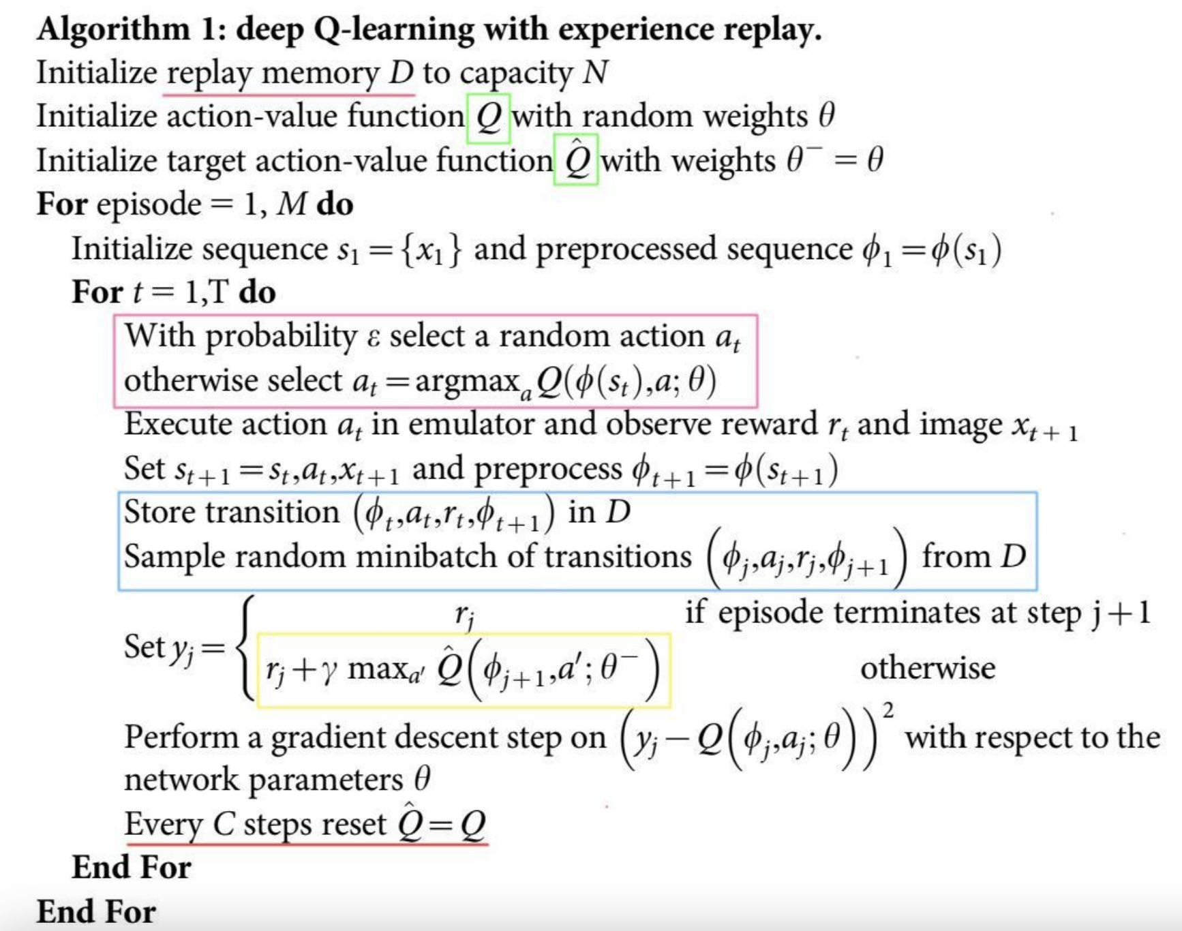
Deep Q Networks
Deep Q-Network (DQN) is a reinforcement learning algorithm that combines traditional Q-Learning with deep learning.
In DQN, a neural network is used as a function approximator for the Q-function. The network takes a state as input and outputs Q-values for each possible action.
The Q-values are then used to decide the action to take, similar to traditional Q-Learning.
The Q-value update rule in DQN is as follows:
Q(s, a) = Q(s, a) + α * [r + γ * max Q(s', a') - Q(s, a)]

Slide 8
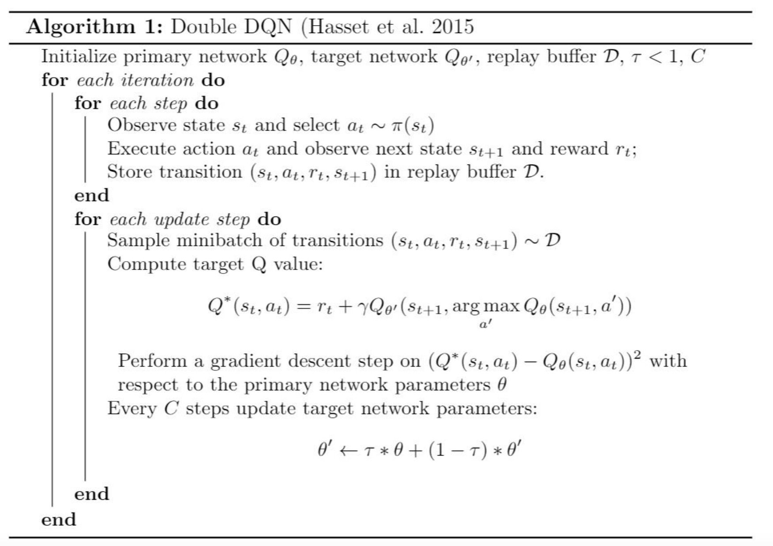
Double DQN
Double Deep Q-Network (Double DQN) is an improvement over the standard Deep Q-Network (DQN) algorithm, designed to mitigate the problem of overestimation of Q-values.
Double DQN, introduced by van Hasselt et al., addresses this issue by using two separate networks with identical architectures: Online Network: It is used to select the best action, given the current state (argmax Q(s, a)). Target Network: It is used to evaluate the action selected by the online network.
The Q-value update rule in Double DQN is as follows:
Q(s, a) = Q(s, a) + α * [r + γ * Q_target(s', argmax Q_online(s', a')) - Q(s, a)]

Slide 9
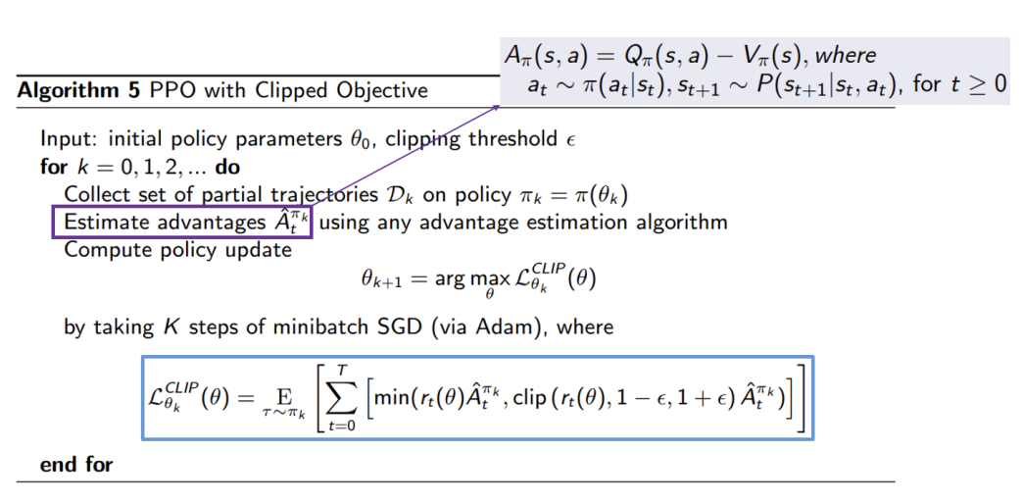
Proximation Policy Optimization (PPO)
Proximal Policy Optimization (PPO) is a type of policy gradient method for reinforcement learning, proposed by OpenAI. It is designed to address some of the challenges associated with other policy optimization methods, such as sample inefficiency and instability.
n PPO, the objective is to optimize the policy in such a way that it doesn't deviate too much from the previous policy. This is achieved by adding a penalty to the objective function which discourages large policy updates.
The objective function for PPO is defined as follows:
L(θ) = 𝔼[min(r(θ) A, clip(r(θ), 1-ε, 1+ε) A)]

Slide 10
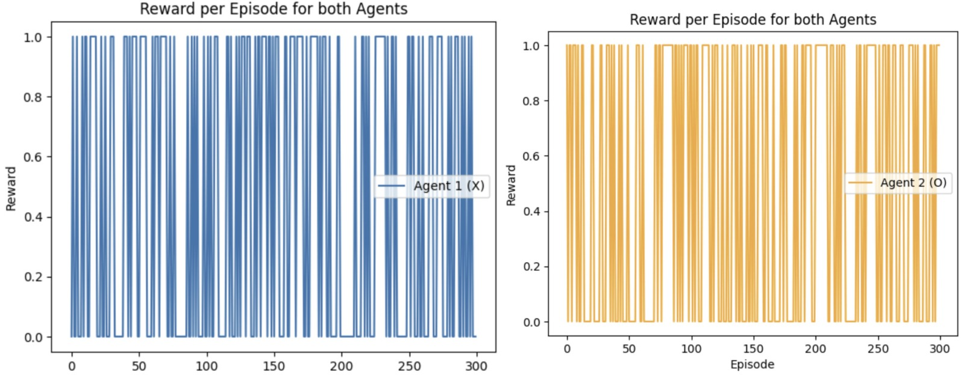
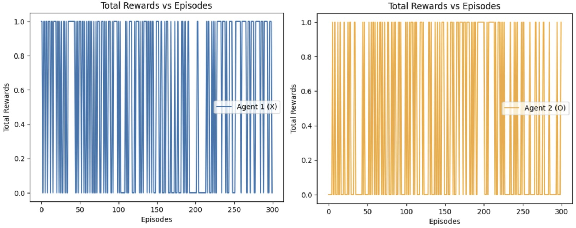
Tic-Tac-Toe
Results
Q- Learning
Double DQN
As the reward set is (1,0,-1) we cannot see that much difference between both the algorithms, but the reward curve is much softer in case of Double DQN resulting in 1 for one agent and -1 for other agent.

Slide 11
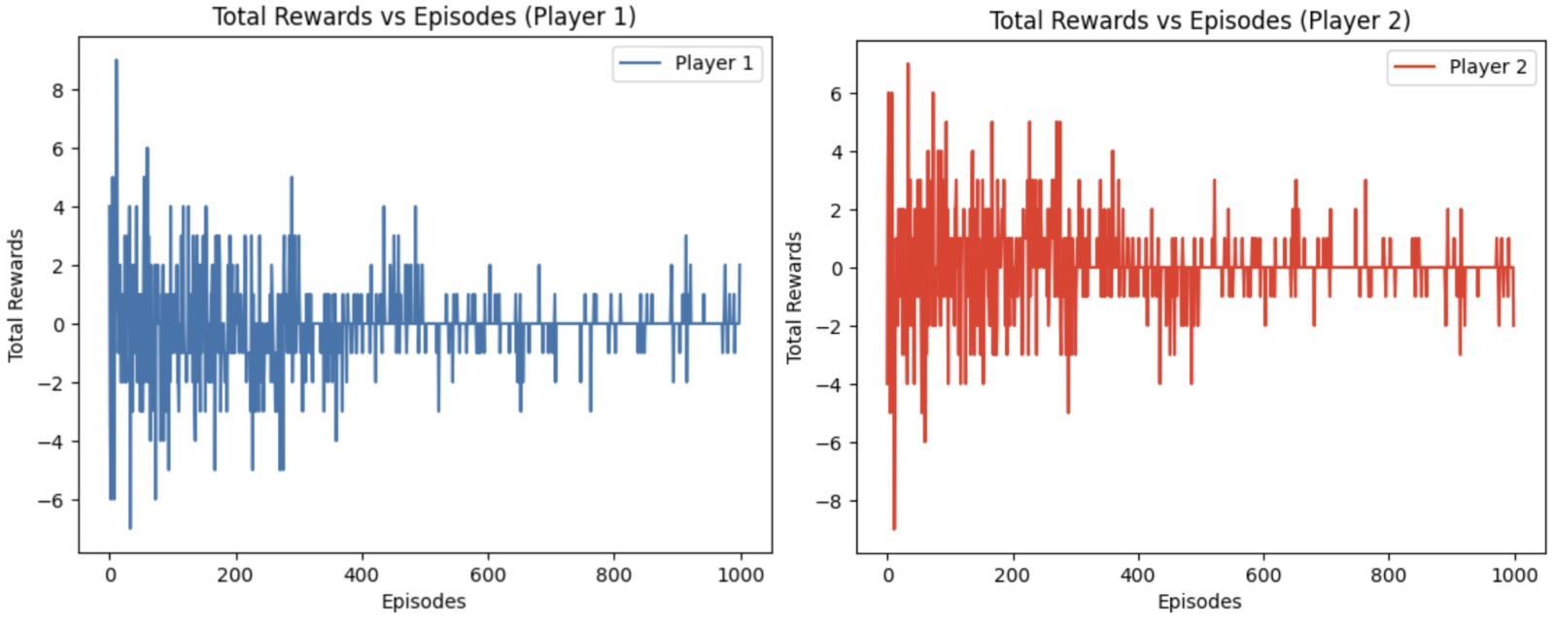
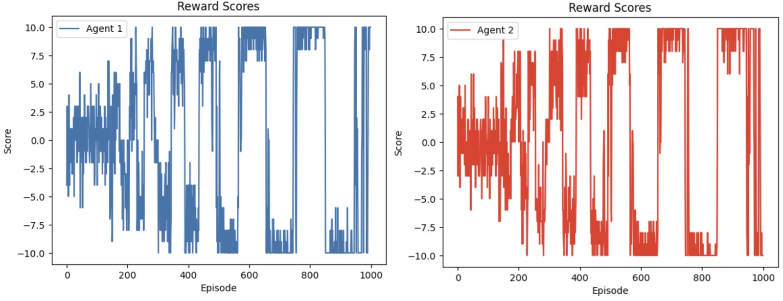
ROCK PAPER SCISSORS
Q-Learning
Double DQN
This environment is a 1 state MDP. But as we are running cumulatively in a single episode, initially Q learning varies a lot but as we go over time rewards tends closer to 0. Whereas in DDQN, the agents gain maximum rewards for a cumulative number of iterations for each episode resulting in more optimal strategy.

Slide 12
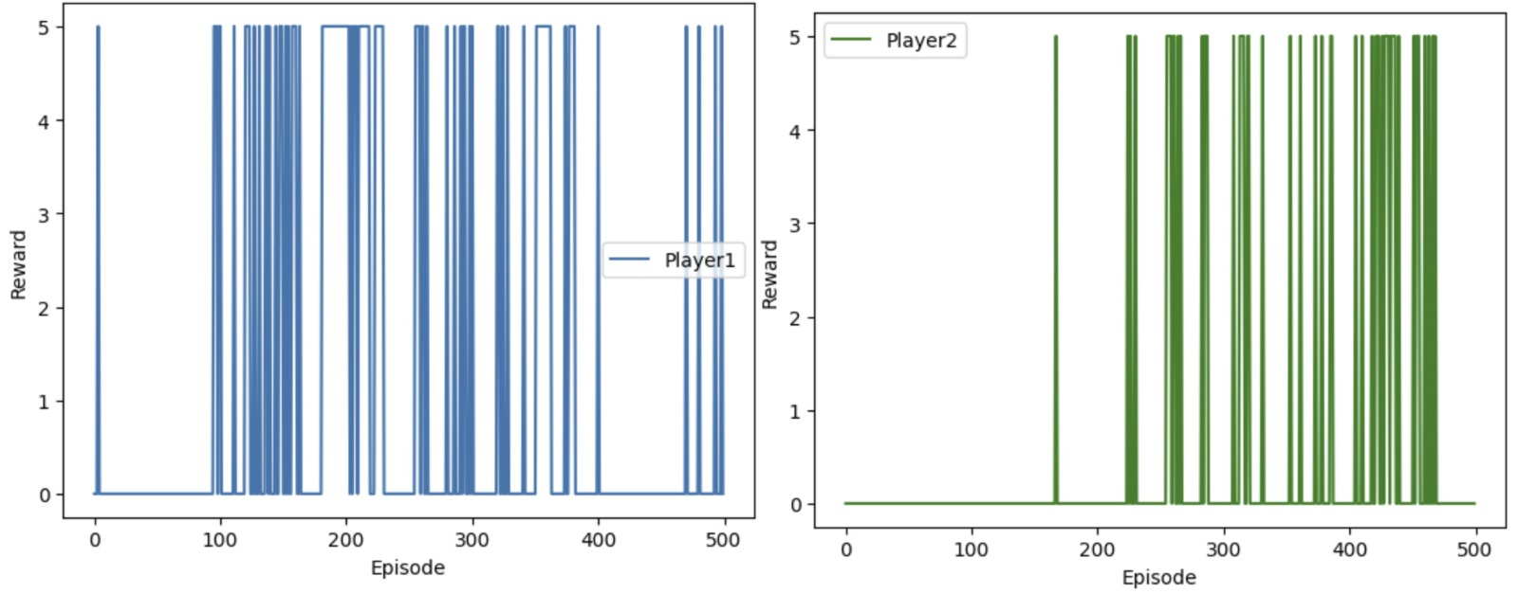
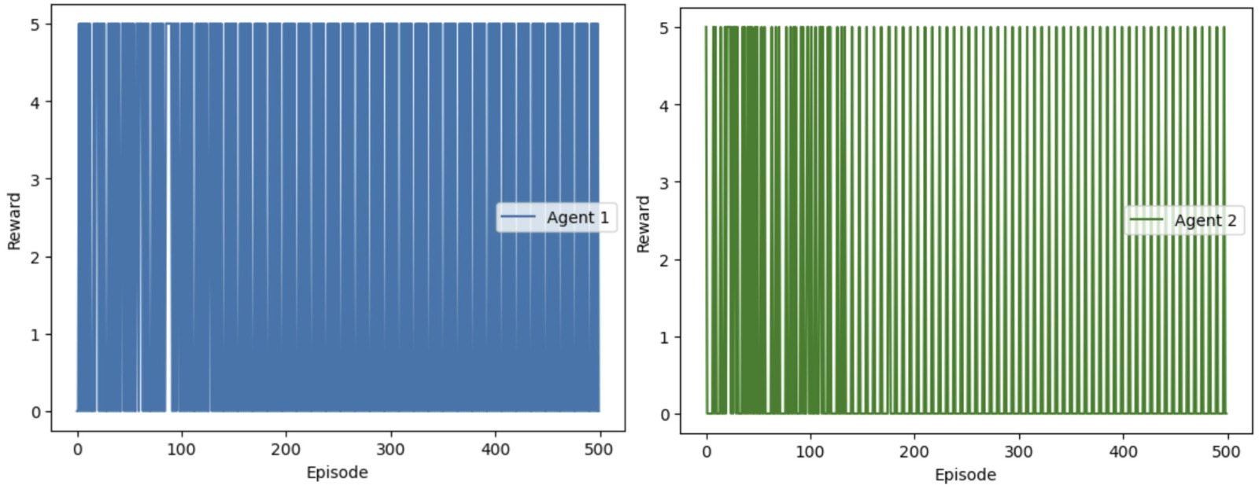
SWITCH GAME
DQN
PPO
Here we can see that the reward set is 5 and zero. For Q - learning, the agent don’t get maximum rewards all of the time making it unstable. Whereas in PPO, most of the time agents are getting maximum rewards.

Slide 13
Future Work
Heterogeneous Agents: the current work has been done on homogeneous agents (where all agents are identical). Exploring environments with heterogeneous agents, having different capabilities or objectives, can lead to more robust and versatile algorithms.
Scalability and Complexity: Handling environments with a large number of agents is still a challenge due to the exponential increase in the complexity of the action and observation spaces. Future work could focus on addressing scalability issues.
How do these agents help in real world scenarios?: In a complex supply chain network, each entity (like suppliers, transporters, warehouses) can be seen as an agent. These agents can learn to coordinate with each other to optimize the overall supply chain efficiency, reduce costs, and respond to demand changes.
What can be done more?: To solve a more complex environment having more than 5 Heterogeneous agents having continuous action and observation spaces using novel methods on existing Deep RL algorithms to achieve highest optimization that can solve Real-World problems effectively.

Slide 14
References
CSE 4/546 Reinforcement Learning slides by Dr. Alina Vereshchaka
https://github.com/cjm715/mgym
https://github.com/openai/gym
https://arxiv.org/pdf/1906.01470.pdf
https://github.com/koulanurag/ma-gym/tree/master/ma_gym
https://cse.buffalo.edu/~avereshc/UBRL_19/Zhi_Wen_Huang_and_Weijin_Z hu_Tic-Tac-Toe_with_Deep_Multi-Agent.pdf
https://towardsdatascience.com/q-learning-algorithm-from-explanation-to-implementation-cdbeda2ea187
https://pytorch.org/tutorials/intermediate/reinforcement_q_learning.html
https://towardsdatascience.com/double-deep-q-networks-905dd8325412
https://towardsdatascience.com/proximal-policy-optimization-ppo-explained-abed1952457b
https://pillow.readthedocs.io/en/stable/
https://pytorch.org/docs/stable/library.html
https://gymnasium.farama.org/
https://openai.com/research/openai-baselines-ppo

Slide 15
Contributions
Team Member | Environments | Contribution (%)
Thilak Reddy Dharam | Tic Tac Toe | Implemented Q - Learning (100 %)
Dhanush Kumar Reddy Yarragonda | Tic Tac Toe | Implemented DDQN (100 %)
Thilak Reddy Dharam | Rock Paper Scissors | Implemented DDQN (100 %)
Dhanush Kumar Reddy Yarragonda | Rock Paper Scissors | Implemented Q - Learning (100 %)
Thilak Reddy Dharam | Switch Game | Implemented PPO (100 %)
Dhanush Kumar Reddy Yarragonda | Switch Game | Implemented DQN (100 %)
Thilak Reddy Dharam | Post Implementation Analysis and Future Work | 50 %
Dhanush Kumar Reddy Yarragonda | Post Implementation Analysis and Future Work | 50 %

Slide 16
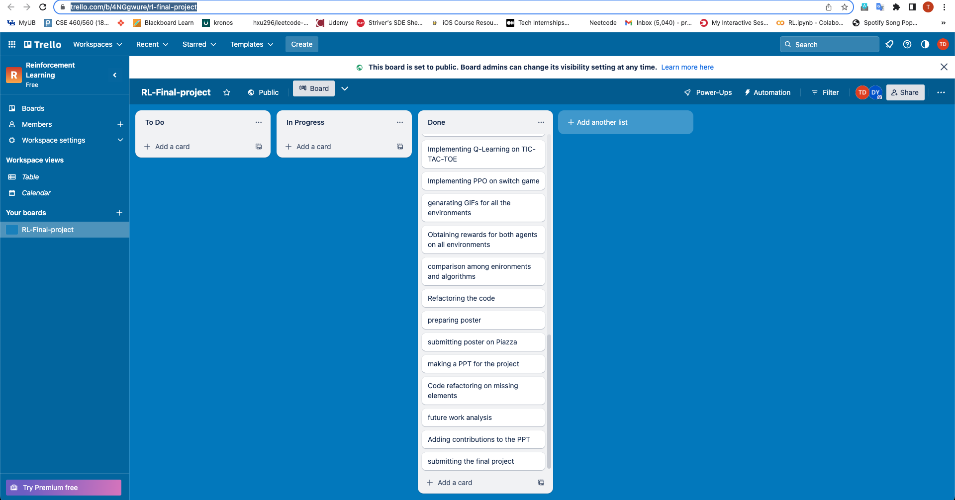
Trello Board Setup
Link: https://trello.com/b/4NGgwure/rl-final-project

